Slide 1
CS 168 Routing Fundamentals
Fall 2015
Scott Shenker
http://inst.eecs.berkeley.edu/~cs168/fa15/

Slide 2
Administrivia
Everyone should have an account
Homework #1 will be posted tomorrow morning
No, I have no control over the waiting list
We have a new TA

Slide 3
Agenda for Today
Finish up last lecture (Design Goals)
Review the course so far
Fundamentals of Routing

Slide 4
Internet Design Goals

Slide 5
David Clark
Wrote a paper in 1988 that tried to capture why the Internet turned out as it did
In particular, it described an ordered list of priorities that informed the design

Slide 6
Internet Design Goals (Clark ‘88)
Connect existing networks (Kahn’s stated goal)
Robust in face of failures
Support multiple types of delivery services
Accommodate a variety of networks
Allow distributed management
Easy host attachment
Cost effective
Allow resource accountability
Notes:
Important that his is an ORDERED list.

Slide 7
#1 Connect Existing Networks
Wanted single protocol that could be used to connect any pair of (existing) networks
The Internet Protocol (IP) is that unifying protocol
All (existing) networks must be able to implement it
This is where the need for best effort arose….
And this is where circuit switching died
Why?

Slide 8
#2 Robust
Def’n A: As long as network is not partitioned, two hosts should be able to communicate (eventually)
Must eventually recover from failures
Def’n B: Failures (excepting network partition) should not interfere with endpoint semantics
Must always isolate endpoints from failures
A: Very successful, not clear how relevant now
Availability more important than recovering from disaster
B: This notion of robustness is underappreciated
Key to modularity of Internet

Slide 9
The Internet Architecture
Layer | Scope | Granularity | Where | Unique?
Application | Host | Data | Host | No
Reliability | Global | Data | Host | No
Network | Global | Packets | Network | Yes
Link | Local | Packets | Network | No
Physical | Local | Bits | Network | No

Slide 10
The Telephony Architecture
Layer | Scope | Granularity | Where | Unique?
Application | Host | Data | Network And Host | No
Reliability | Global | Data | Network | No
Network | Global | Packets | Network | Yes
Link | Local | Packets | Network | No
Physical | Local | Bits | Network | No

Slide 11
#3 Types of Delivery Services
Use of the term “delivery services” already implied an application-neutral network
Built lowest common denominator service
Allow end-based protocols to provide better service
For instance, turn unreliable service into reliable service
Example: recognition that TCP wasn’t needed (or wanted) by some applications
Separated TCP from IP, and introduced UDP

Slide 12
The paradox of the Internet’s design
The goal is to support many applications
These applications have different requirements
Shouldn’t the Internet support them all?
That is, provide a service the satisfies all of them
By meeting the most stringent requirements

Slide 13
What service should Internet support?
Strict delay bounds?
Some applications require them
Guaranteed delivery?
Some applications are sensitive to packet drops
No applications mind getting good service
Why not require Internet support all these guarantees?

Slide 14
Important life lessons
(1) People (or applications)
Don’t always need what they think they need
Almost never need what we think they need
(2) Flexibility often more important than performance
But typically only in hindsight!
Example: cell phones vs landlines
(3) Architect for flexibility, engineer for performance
Flexibility ensures longevity
Performance requirements are ephemeral

Slide 15
Applying lessons to Internet
Requiring performance guarantees would limit variety of networks that could attach to Internet
Many applications don’t need these guarantees
And those that do?
Well, they don’t either (usually) (Why?)
Tremendous ability to mask drops, delays
And ISPs can work hard to deliver good service without changing the architecture (engineering)

Slide 16
Bottom Line
The choice of “best-effort” packet switching service is not as obvious as it might seem today
Great vision on the part of the Internet designers
And lucky that they were focused on applications that did not need great service

Slide 17
#4 Variety of Networks
Incredibly successful!
Minimal requirements on networks
No need for reliability, in-order, fixed size packets, etc.
A result of aiming for lowest common denominator
IP over everything
Then: ARPANET, X.25, DARPA satellite network..
Now: Wifi, Cellular, ATM, SONET, WDM…

Slide 18
#5 Decentralized Management
Both a curse and a blessing
Important for easy deployment
Makes management hard today
Recent efforts have improved management of individual networks
But no attempt to manage the Internet as a whole….

Slide 19
#6 Host Attachment
Clark observes that cost of host attachment may be higher because hosts have to be smart
But the administrative cost of adding hosts is very low, which is probably more important
Plug-and-play kind of behavior….

Slide 20
#7 Cost Effective
Cheaper than circuit switching at low end
More expensive than circuit switching at high end
Why?
Not a bad compromise:
Cheap where it counts (low-end)
More expensive for those who can pay….

Slide 21
#8 Resource Accountability
Failure!

Slide 22
Internet Motto
We reject kings, presidents, and voting. We believe in rough consensus and running code.”
David Clark

Slide 23
Real Goals
Build something that works!
Connect existing networks
Robust in face of failures
Support multiple types of delivery services
Accommodate a variety of networks
Allow distributed management
Easy host attachment
Cost effective
Allow resource accountability

Slide 24
Questions to think about….
What priorities would a commercial design have?
Probably focus on high-revenue applications
What would the resulting design look like?
Probably bake some of the application into the network
What goals are missing from this list?
Suggestions?

Slide 25
Some of the missing issues
Security
Resilience to attacks (denial-of-service)
Endpoint security
Tracking down misbehaving users
Privacy
Availability
Resource sharing (fairness, etc.)
ISP-level concerns
Technical issues of interconnection and internal management
Economic issues of interconnection
Value flow (who should get paid for these bits?)

Slide 26
The Course So Far….

Slide 27
Internet Architecture is an Exercise in Modularity
Modularity led to the basic design decisions
And these design decisions have enabled the Internet to scale in:
Size
Speed
Diversity of technologies
Diversity of applications
Diversity of end points

Slide 28
Decisions and Their Principles
How to break system into modules
Dictated by Layering
Where modules are implemented
Dictated by End-to-End Principle
Where state is stored
Dictated by Fate-Sharing

Slide 29
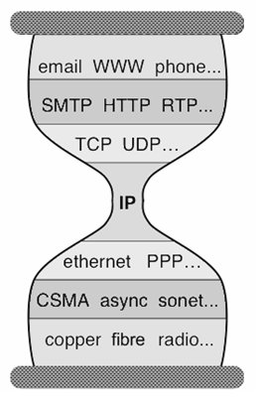
Five Layers
Applications
…built on…
Reliable (or unreliable) transport
…built on…
Best-effort global packet delivery
…built on…
Best-effort local packet delivery
…built on…
Physical transfer of bits

Slide 30
Traditional Courses
Cover each layer in order (as in our textbook)
Philosophies differ as to top-down vs bottom-up
I prefer to focus on the distinction between
Fundamental intellectual challenges
Design/implementation choices in today’s Internet
We will next address fundamental challenges
Later will discuss current designs in each layer

Slide 31
Which of these tasks are hard?
Application: not a fundamental challenge
Not general, and not necessarily hard
Reliable transport: a fundamental challenge
General, and difficult
Global and local packet delivery:
Local and global packet delivery both require routing
This is a general and difficult challenge
Physical transfer: not a fundamental challenge
Not general, and not conceptually difficult

Slide 32
Two Fundamental Challenges
Routing: guiding packets from source to destination
Reliable delivery: building a reliable transport service on top of best-effort delivery
Other pieces required to build operational networks
Naming, addressing, congestion control,….
We will get to those later in the course
But these two are inherent and hard
Routing: next few lectures
Reliable transport: lecture after that

Slide 33
A Few Preliminaries
Before we can study routing, we need to clarify:
Network Topologies
Switches/Routers
Forwarding
Packets

Slide 34
Example of Network Graph
Router with 6 attached links
Router with 4 attached links

Slide 35
A Variety of Networks
ISPs: carriers
Backbone
Edge (connecting to customers)
Border (to other ISPs)
Enterprises: companies, universities
Core
Edge (connecting to hosts)
Border (to outside)
Datacenters: massive collections of machines
Aggregation and Core
Top-of-Rack
Border (to outside)

Slide 36
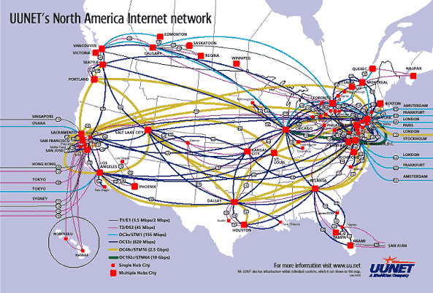
UUNET’s North American Network
Notes:
Very irregular

Slide 37
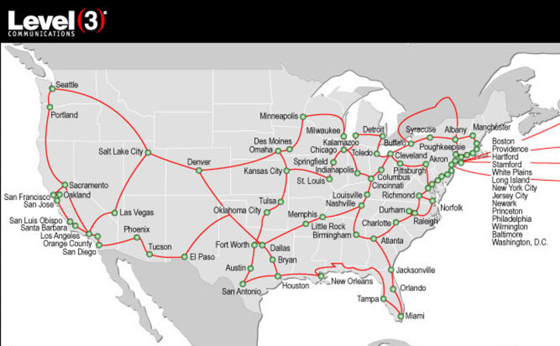
Level3’s American Network (check out their interactive map)

Slide 38
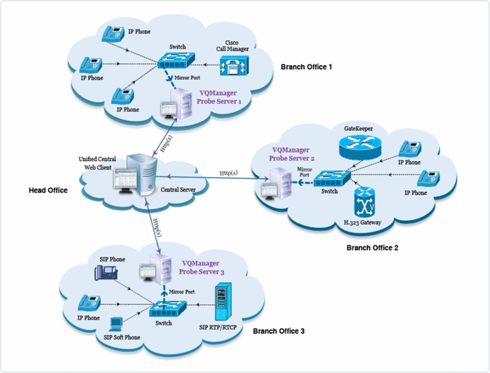
Enterprise Network
Notes:
Not very detailed, couldn’t get a better one….

Slide 39
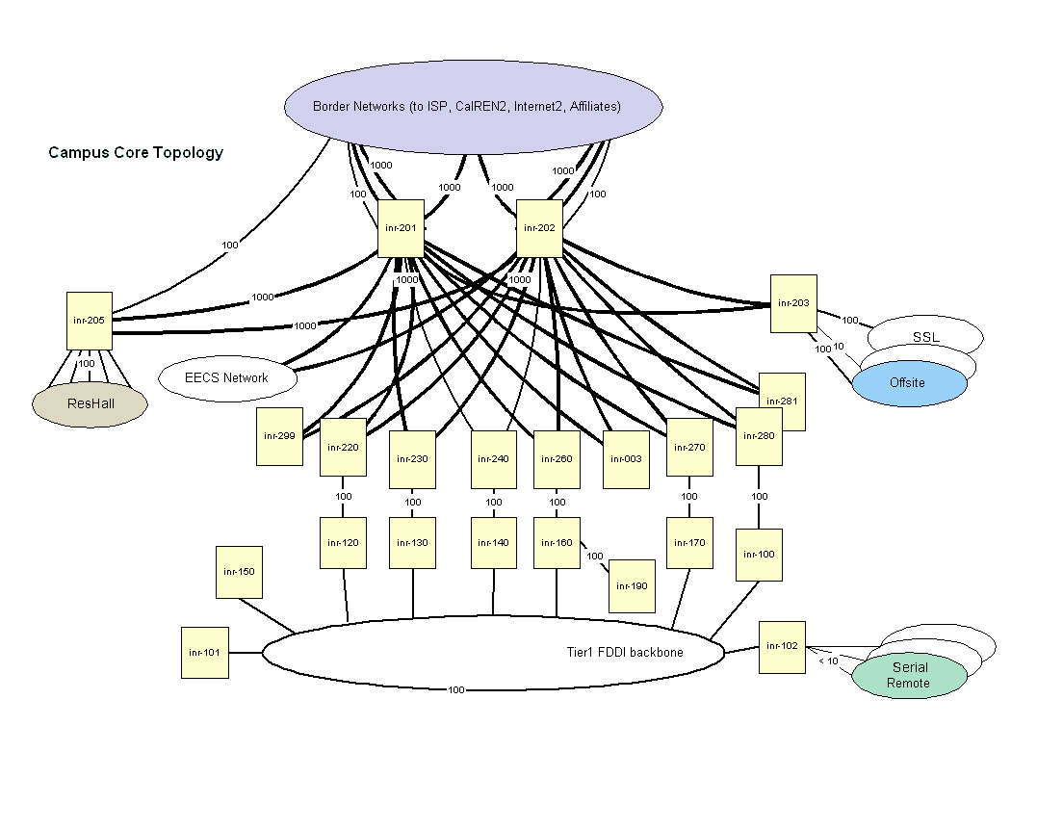
Berkeley’s Campus Network

Slide 40
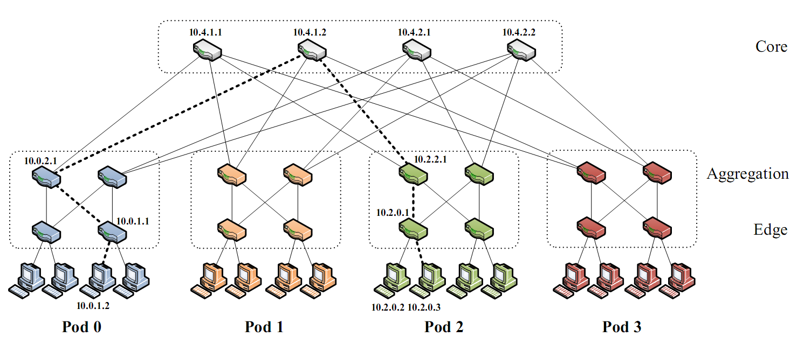
Partial Datacenter Network
Notes:
Only a part of the network, but the takeaway is that the network is very regular, involving levels of hierarchy.

Slide 41
Switches/Routers
Multiple attached links, often called “ports”
Ports are typically duplex (incoming and outgoing)
But in this picture will show them separately
(Don’t confuse this notion of “port” with transport “ports”)
incoming links
Switch
outgoing links

Slide 42
Forwarding Decisions
When packet arrives, must choose outgoing port
Decision is based on routing state (table) in switch
incoming links
Switch
outgoing links
Consider
packet header
and routing
table

Slide 43
Forwarding Decisions
Switches and routers make the following mapping:
PacketState + RoutingState ➔ OutgoingPort
Most do so in single transmission time
Forwarding decisions must be simple
Assume forwarding decisions are deterministic
Packets with same state always routed to same port

Slide 44
Packets (at a conceptual level)
Assume packet headers contain:
Destination ID
Source ID
…and perhaps other information
Destination
Identifier
Why include
this?
Source
Identifier
Payload

Slide 45
Forwarding Decision Dependencies
Must depend on destination
Could also depend on :
Source: requires n² state
Input port: not clear what this buys you
Other header information: ignore for now
We will focus only on destination-based routing
But first consider the alternative

Slide 46
Source/Destination-Based Routing
Paths from two different sources (to same destination) can be very different

Slide 47
Destination-Based Routing
Paths from two different sources (to same destination) must coincide once they overlap
Notes:
Why coincide?

Slide 48
Destination-Based Routing
Paths to same destination never cross
Once paths to destination meet, they never split
Set of paths to destination create a “delivery tree”
Must cover every node exactly once
Only one outgoing arrow at each node
All nodes have path to destination
Produces Spanning Tree rooted at destination
Notes:
You all know what a spanning tree is?

Slide 49
A “Delivery Tree” for a Destination

Slide 50
Assume Destination-Based Routing
For rest of lecture (and course)…..

Slide 51
to UCB
to MIT
switch#4
switch#2
Forwarding Table
111010010
MIT
Destination | Next Hop
UCB | switch#4
UW | switch#5
MIT | switch#2
NYU | switch#3
switch#5
to UW
to NYU
switch#3

Slide 52
Forwarding
The act of forwarding in a router:
Read address from packet’s header
Search routing state for correct output port
Send (within router) to correct output port
Forwarding is a local process within a router

Slide 53
to UCB
to MIT
switch#4
switch#2
111010010
MIT
Forwarding Table
Destination | Next Hop
UCB | switch#4
UW | switch#5
MIT | switch#2
NYU | switch#3
switch#1
switch#5
to UW
to NYU
switch#3

Slide 54
Routing
Routing is what computes the routing state
Also called forwarding state
This is inherently a global process
How can you know where to send packets without knowing what the overall network looks like?

Slide 55
Destination | Next Hop
UCB | switch#1
UW | switch#1
MIT | switch#6
NYU | switch#1
to UCB
to MIT
switch#4
switch#2
Forwarding Table
111010010
MIT
Destination | Next Hop
UCB | switch#4
UW | switch#5
MIT | switch#2
NYU | switch#3
Destination | Next Hop
UCB | switch#1
UW | switch#1
MIT | switch#1
NYU | switch#1
switch#1
to UW
switch#5
to NYU
switch#3

Slide 56
Forwarding vs Routing
Forwarding: “data plane”
Directing a data packet to an outgoing link
Individual router using routing state
Routing: “control plane”
Computing paths the packets will follow
Routers talking amongst themselves
Jointly creating the routing state
Two very different timescales….
Nanoseconds vs (hopefully) 10s of milliseconds

Slide 57
Local vs Global View of State
Local routing state is table in a single router
By itself, the state in a single router can’t be evaluated
It must be evaluated in terms of the global context
Global state is collection of tables in all routers
Global state determines which paths packets take
(Will discuss later where this routing state comes from)

Slide 58
Destination | Next Hop
UCB | switch#1
UW | switch#1
MIT | switch#6
NYU | switch#1
to UCB
to MIT
switch#4
switch#2
Forwarding Table
111010010
MIT
Destination | Next Hop
UCB | switch#4
UW | switch#5
MIT | switch#2
NYU | switch#3
Destination | Next Hop
UCB | switch#1
UW | switch#1
MIT | switch#1
NYU | switch#1
switch#1
to UW
switch#5
to NYU
switch#3

Slide 59
“Valid” Routing State
Global routing state is “valid” if it produces forwarding decisions that always deliver packets to their destinations
Valid is my terminology, not standard
Goal of routing protocols: compute valid state
But how can you tell if routing state if valid?
Need a succinct correctness condition for routing
Suggestions?
Notes:
What could go wrong?

Slide 60
Necessary and Sufficient Condition
Global routing state is valid if and only if:
There are no dead ends (other than destination)
There are no loops
A dead end is when there is no outgoing port
A packet arrives, but the forwarding decision does not yield any outgoing port
A loop is when a packet cycles around the same set of nodes forever

Slide 61
Packet Hitting Dead End
Packet reaches deadend and stops (and dropped)

Slide 62
Packet Entering Loop
Packet falls into loop and never reaches destination

Slide 63
Destination | Next Hop
UCB | switch#1
UW | switch#1
MIT | switch#1
NYU | switch#1
Loop!
to UCB
to MIT
switch#4
switch#2
Forwarding Table
111010010
MIT
Destination | Next Hop
UCB | switch#4
UW | switch#5
MIT | switch#2
NYU | switch#3
Destination | Next Hop
UCB | switch#1
UW | switch#1
MIT | switch#1
NYU | switch#1
switch#1
to UW
switch#5
to NYU
switch#3

Slide 64
Destination | Next Hop
UCB | switch#1
UW | switch#1
MIT | switch#1
NYU | switch#1
Deadend (to MIT)
to UCB
to MIT
switch#4
switch#2
Forwarding Table
111010010
MIT
Destination | Next Hop
UCB | switch#4
UW | switch#5
NYU | switch#3
Destination | Next Hop
UCB | switch#1
UW | switch#1
MIT | switch#1
NYU | switch#1
switch#1
to UW
switch#5
to NYU
switch#3

Slide 65
Logic Refresher
A if B means B ➔ A
if B is true, then A is true
A only if B means A ➔ B
if A is true, then B is true
A if and only if B means: A ⬅➔ B
If A is true, then B is true
If B is true, then A is true
To make the statement that A if and only if B, you must prove statements 1 and 2.

Slide 66
Necessary and Sufficient Condition
Global routing state is valid if and only if:
There are no dead ends (other than destination)
There are no loops
Necessary: (only if)
If routing state valid, then there are no loops/deadends
Sufficient: (if)
If no loops/deadends, then routing state is valid

Slide 67
Necessary (“only if”): Easy
If you run into a deadend before hitting destination, you’ll never reach the destination
If you run into a loop, you’ll never reach destination
With deterministic forwarding, once you loop, you’ll loop forever (assuming routing state is static)
Therefore:
If routing state valid, then there are no loops/deadends

Slide 68
Sufficient (“if”): More Subtle
Assume no deadends, no loops
Packet must keep wandering, without repeating
If ever enter same switch from same port, will loop
Because forwarding decisions are deterministic
Only a finite number of possible ports for it to visit
It cannot keep wandering forever without looping
Must eventually hit destination
Therefore:
If no loops/deadends, then routing state is valid
Notes:
Destination is only safe deadend

Slide 69
Two Questions
How can we verify given routing state is valid?
How can we produce valid routing state?

Slide 70
Checking Validity of Routing State
Focus only on a single destination
Ignore all other routing state
Mark outgoing port with arrow
There can only be one at each node
Eliminate all links with no arrows
Look at what’s left….
State is valid if and only if remaining graph is spanning tree rooted at destination

Slide 71
Example 1

Slide 72
Pick Destination

Slide 73
Put Arrows on Outgoing Ports (output ports towards green dot)

Slide 74
Remove Unused Links
Leaves Spanning Tree: Valid

Slide 75
Second Example

Slide 76
Second Example
Is this valid?

Slide 77
Lesson….
Very easy to check validity of routing state for a particular destination
Deadends are obvious
Node without outgoing arrow
Loops are obvious
Disconnected from destination (and rest of graph)

Slide 78
Two Questions
How can we verify given routing state is valid?
How can we produce valid routing state?

Slide 79
The “Secret” of Routing
Avoiding deadends is easy
Avoiding loops is hard
And here we mean persistent loops
The key difference between routing protocols is how they avoid loops!
Don’t focus on details of mechanisms
Just ask “how are loops avoided?”
Many different variations of route computations
But before I tell you how to route….
Notes:
Most modern routing research is about how to make the loop-freeness a more fundamental part of the algorithm. In what I’m going to present today, it is only loop-free AFTER convergence. That’s not good enough

Slide 80
Learn-By-Doing
I need 40 volunteers
If you haven’t participated, this is your chance!

Slide 81
The Task
Do not look at sheet of paper until I say so
You will have five minutes to complete this task
Each sheet says:
You are node X You are connected to nodes Y,Z
Your job: find route from source (node 1) to destination (node 40) in five minutes

Slide 82
Ground Rules
You may not:
Leave your seat (but you can stand)
Pass your sheet of paper
Let anyone copy your sheet of paper
You may:
Ask nearby friends for advice
Shout to other participants (anything you want)
Curse your instructor (sotto voce)
You must: Try

Slide 83
Go!

